Slide 1
K
Panasonic System Networks Vietnam
Information Systems Section
OQC DIGITAL SYSTEM

Slide 2
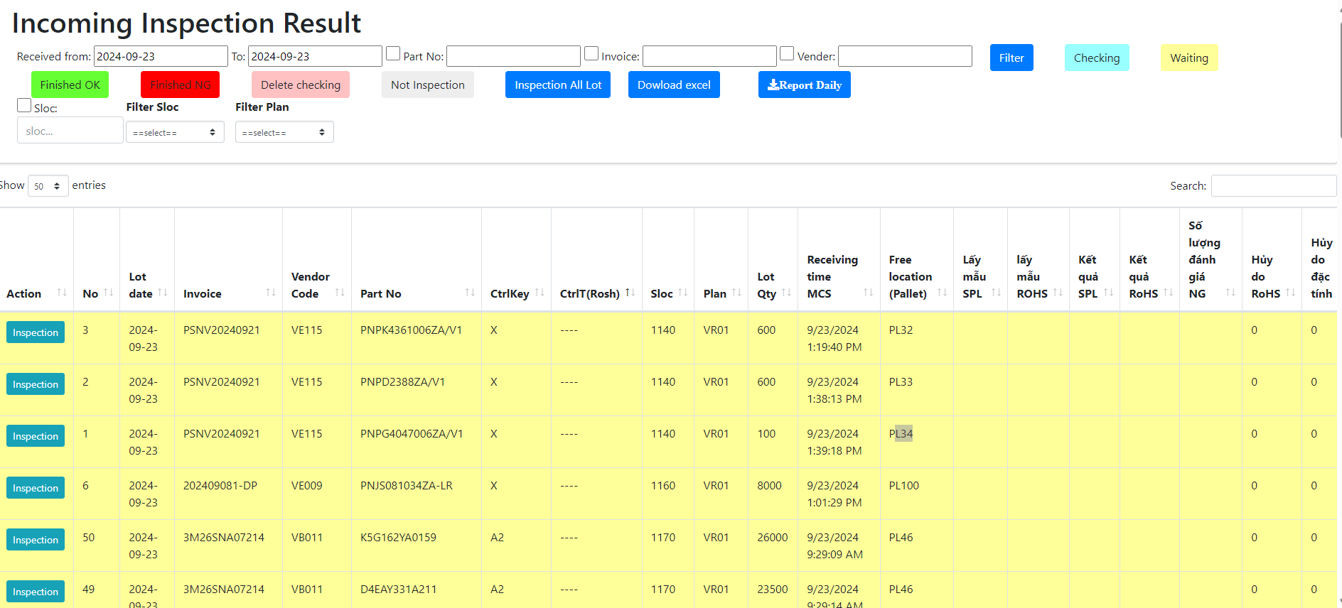



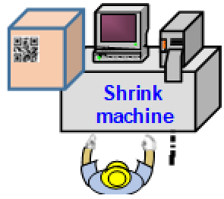




Link weight check system concept
Production
OQC visualize system
Shipment
PEM system
Record 4M change
Process quality issue
Purpose
Indicate process 4M/ Quality each Lot
Visualize OQC checking status
Indicate shipment permission
Trace back for Market feedback
VMS system
Visualize status of model following shipment plan daily
Link final confirmation to WMS/PDA
ADD
ADD
ADD
ADD
Weight check system
Production result
Link with ID pallet system
Shipment request (Priority)
Advantage
Remove manual Job FA/OQC/SCM
Eliminate human risk & follow up quality /4M issue to evaluate LOT
Visualize shipment permission timely
ADD
Visualize OQC inspection result
Link
Link
Link
PEM
System
Weight check
System
OQC system
ID pallet
VMS
System
Shipment
Production : △… H
QC : △2pax
SCM : △… H
Auto system replace manual Job and visualize quality /4M information to evaluate Lot for shipment

Slide 3
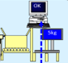
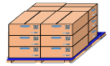



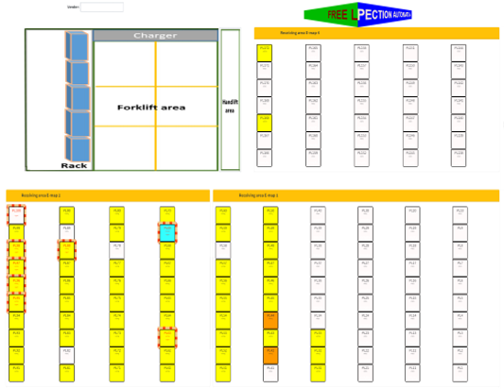
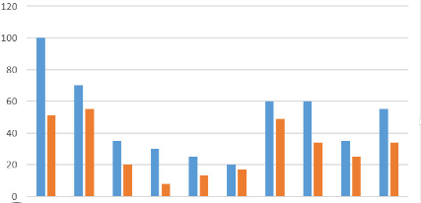



OQC DIGITAL SYSTEM
1
1
Pick up simple
OQC Inspection
Chop stamp physical
Shipment
OQC manual control when picking up samples
FA does not control quantity of OQC pick-up
No indicate shipment priority
Manual control weight check
Update OQC result not timely
Each step is an independent, easy-skip process
Manual make report
OQC: Loss time to find and chop stamp.
FA loss of time to check stamps by appearance check
SCM loss of time to confirm OQC inspection result to input WMS
CURRENT
OQC inspection
E-Map control
Visualize OQC inspection result
Software
OQC
Pick sample
OQC Judgement all lot
Weight check
Database Weight check
Database OQC
NEW SYSTEM
WMS
Return sample
FA create Pallet ID
FA In/Out location
Visualize shipment priority, control quantity pickup
Shrink machine
FA, SCM warehouse
System indicate S/N OQC pickup
Indicate models shipment priority
System indicate OQC & Lot judgment
Reduce manual job OQC
➔ Save: 1,000H/year
E-chop and indication on system
FA: Save 213.4$/year
OQC: ∆2pax
E-chop and indication on system
SCM: Save 800H/year
AFTER

Slide 4
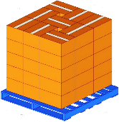
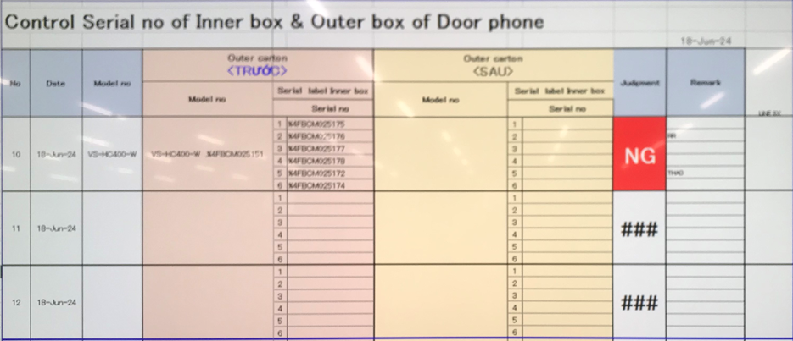
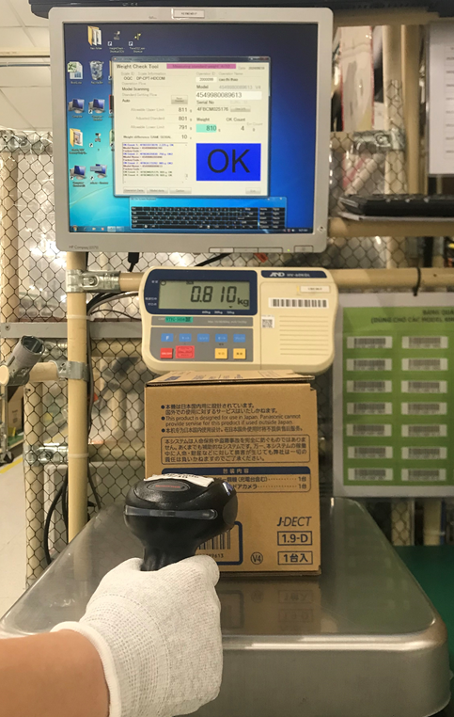
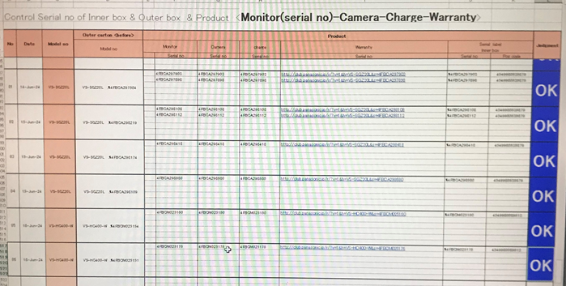
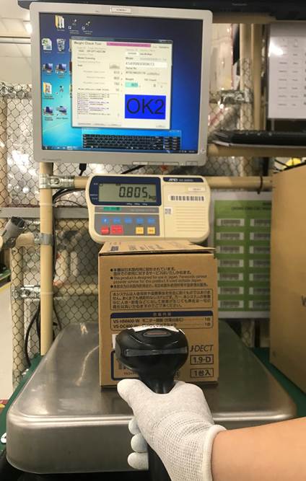
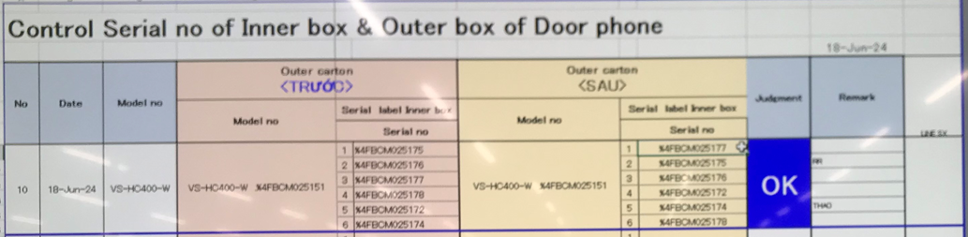


OQC DIGITAL SYSTEM
2
Control process sample at OQC area
Pick up sample
Reading barcode Inner/Outer excel file
Weight check 1st
OQC
inspection
Reading BC
Product/Inner excel file
Weight check 2nd
Reading barcode
Inner/Outer excel file
Return sample
No Link
2
No Link
3
4
No Link
5
6
7
8
1
No Link
Reliability
No Link
No Link
No Link
Production Line
Confirm S/N Outer & all inner boxes
Accessory control
Numbering control & Separate area
Product / Warranty/ Manual & Inner box
Accessory control
Confirm S/N Outer & all inner boxes
Warehouse FA
OQC inspection result no link FA & SCM system, easy mistake.
All procedures are manual by Excel, loss time to traceability, and skip processes.
The results of the inspection process are manually stamped. Loss of time to stamp.
Improvement
Steps
1
2
3
4
5
6
7
8
Auto link weight FA
Auto link weight FA
Database server OQC
Control pick-up quantity

Slide 5

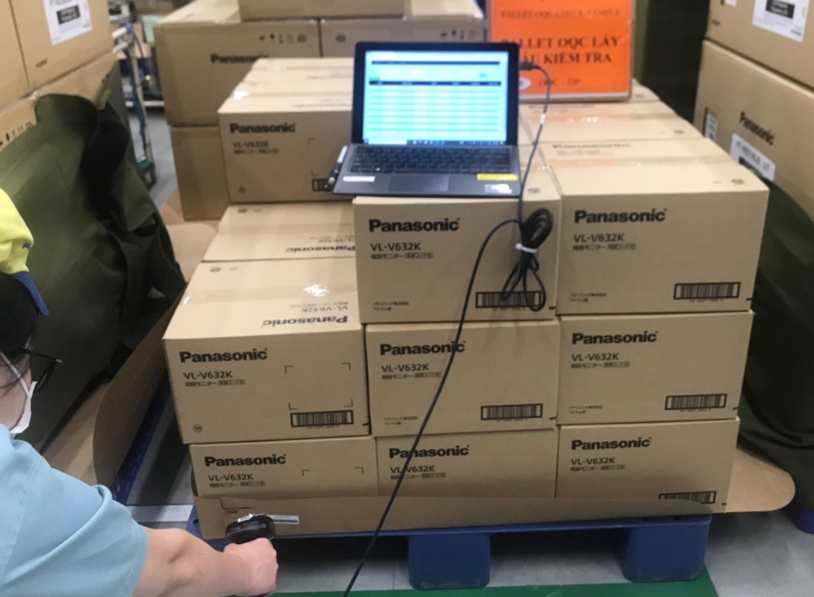
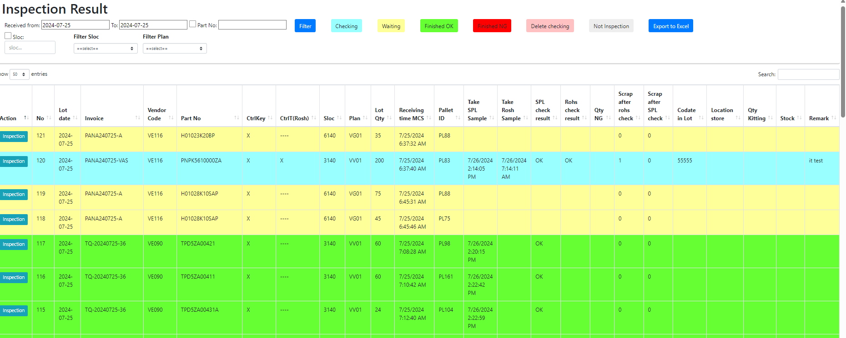

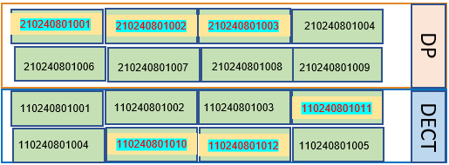



OQC DIGITAL SYSTEM
3
E chop for OQC inspection
OQC inspection
OK
Steps
9
10
11
12
13
14
Day- Month- Year
OQC
Weight check
NG
OK
OQC member pick up sample
Auto judgment OK for
All pallet ID the same Model, production date, line and shift.
Use physical stamp
New system link FA-SCM-OQC
NG Location
Database server
FA
Link
OQC
Link
SCM
Visualize OQC inspection
DP area
E – chop can
replace
Shrink machine
OK
OQC return sample
FA shrink pallet ID
FA fix location
Day- Month- Year
OQC
Visualize FA Warehouse area
SCM Warehouse
SCM Out location
SCM area
DECT area
WMS system
Shipping To market

Slide 6
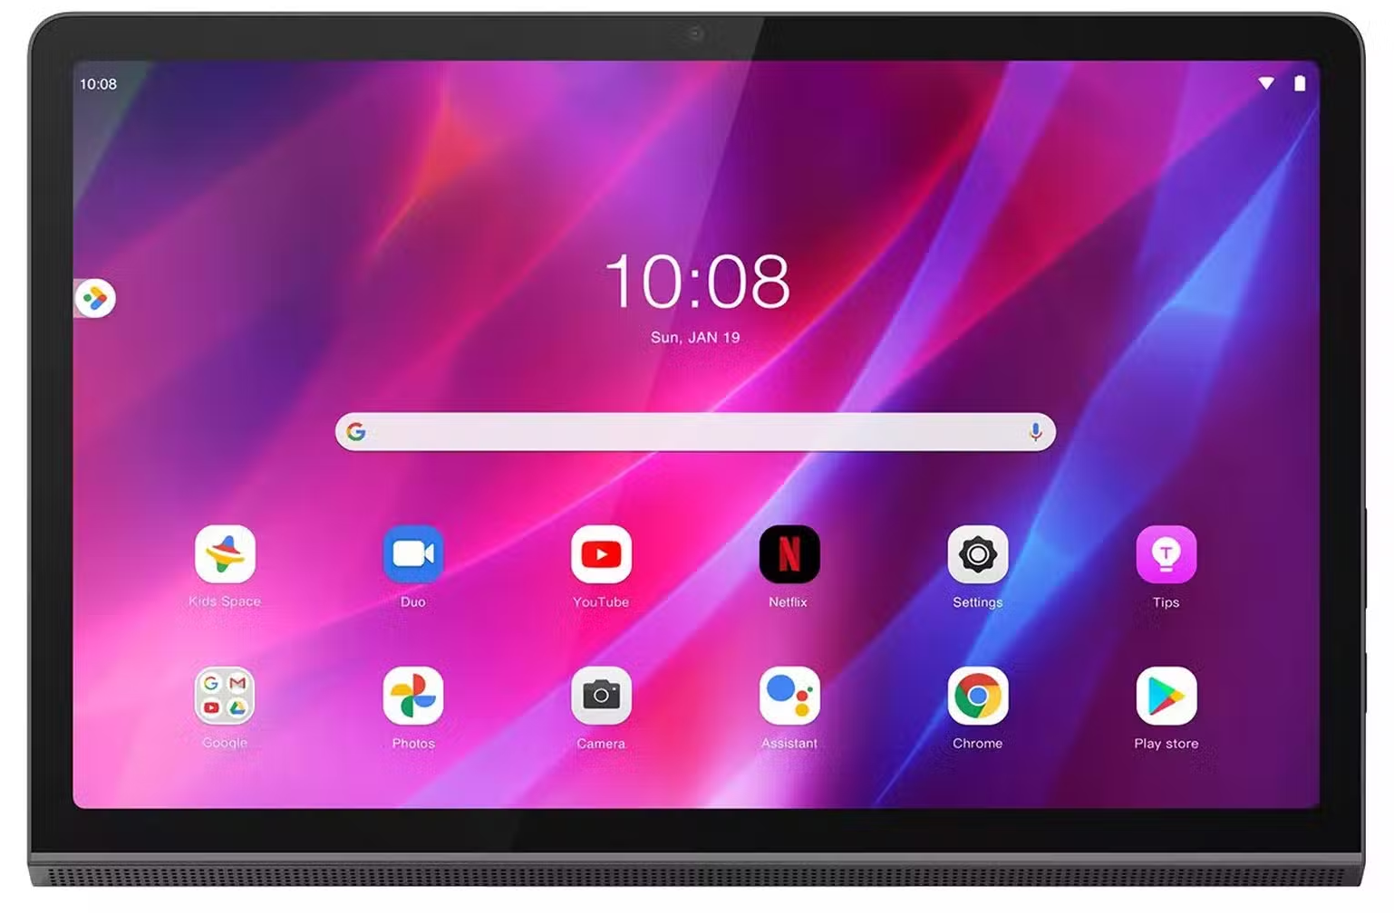

OQC DIGITAL SYSTEM
Procurement activity
4
Equipment list require
Section | Name Equipment | Image | Function | Quantity
OQC | Tablet windows (Connect with barcode reader) |  | 1.1 Pick up sample 1.2 Return Sample 1.3 Find quickly Pallet ID and Model at FA & SCM area 1.4 Visualize OQC inspection with FA, SCM | 3
FA | Mobile device |  | 2.1 Fix in & fix out location 2.2 Check the status of the OQC inspection | 2

Slide 7
OQC DIGITAL SYSTEM
5
Project Schedule
Plan
Actual
Go-live
Group Function | Department | Aug | Sep | Oct | Nov | Dec | Jan | Feb | Mar
Meeting, discuss, analyze | SCM/QC/FA/IT
Upload plan, Pick-up sample | SCM/QC/FA/IT
Confirm Outer carton and inner box | QC/IT
Modify weight check OQC | QC/IT
OQC inspection & judgment all lots | SCM/QC/FA/IT
Visualize inspection result OQC | -SCM/QC/FA/IT
Report daily OQC | QC/IT

Slide 8
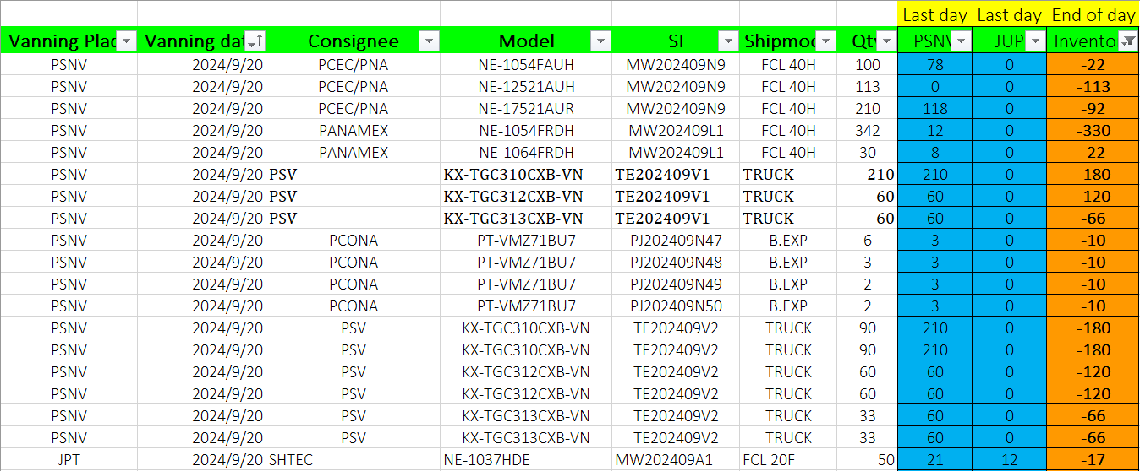
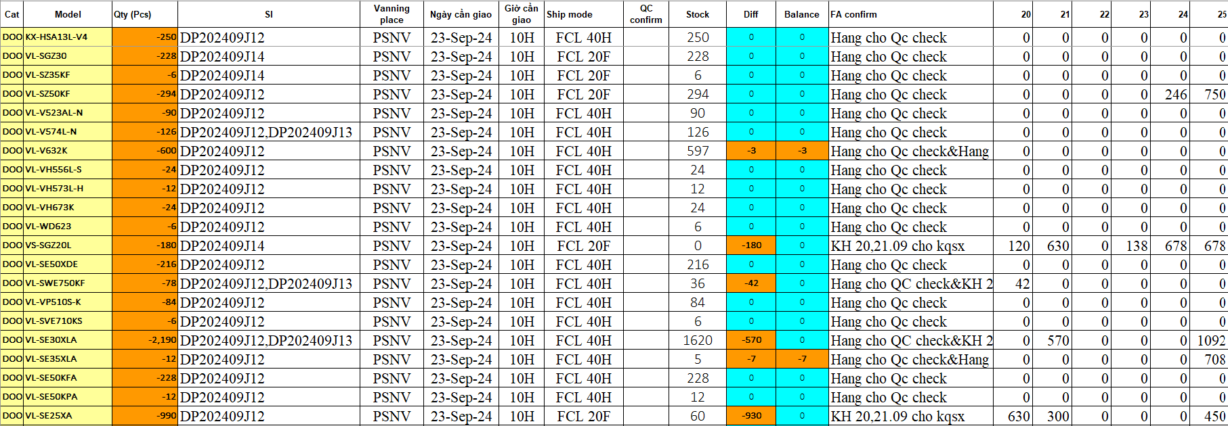
OQC DIGITAL SYSTEM
6
5
OQC confirm shipment plan to focus priority shipment models by manual
◆ Current
◆ Proposal
Step 1: SCM send inventory & shipment plan
Request system will be displayed details:
Indicate priority shipment model to announce OQC pick up inspection
Indicate details: Ship by Board/Air, Stock Q'ty, shipment Q’ty, Minus product compare vs shipment plan
Minus product: Q’ty, Reason, when re-running (need indicate)
In case production plan be changed → Auto refresh
Classify type of product and display : EMC, PP, PMP and can shipment or not (Ex: PP cannot shipment..)
Step 2: FA update inventory & shipment plan
Step 3: OQC input shipment info to focus check priority
Using time: 5 mins/day*4 BD/BU =20 mins/day
Save time: 20 mins/day

Slide 9
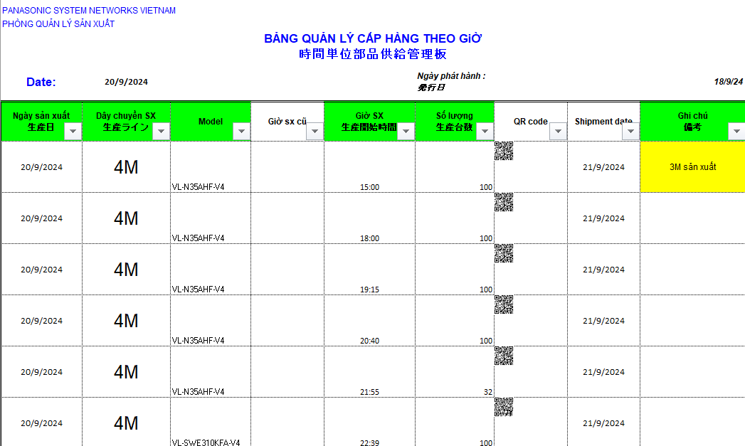
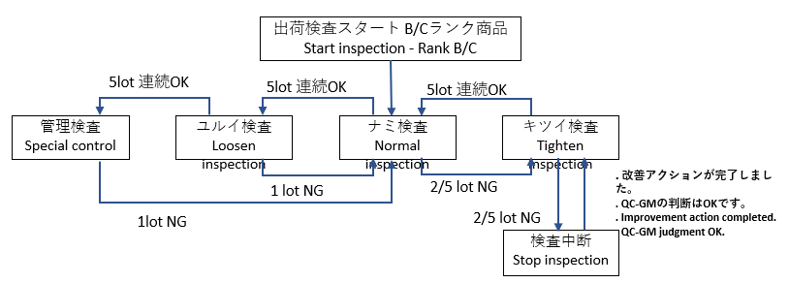
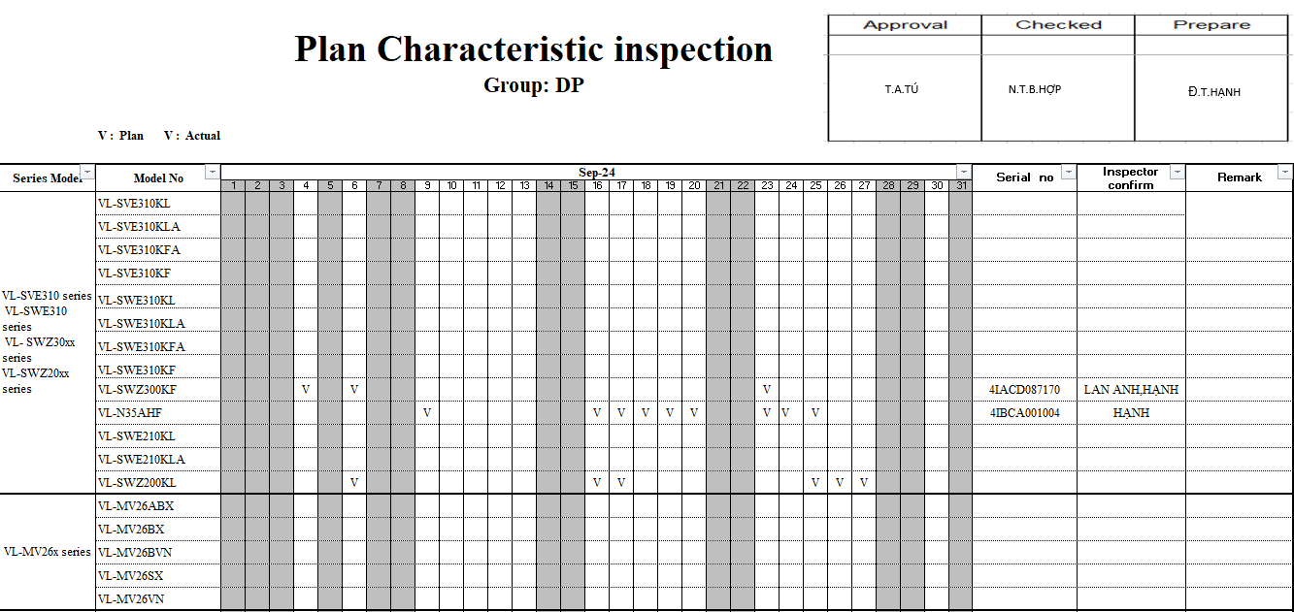
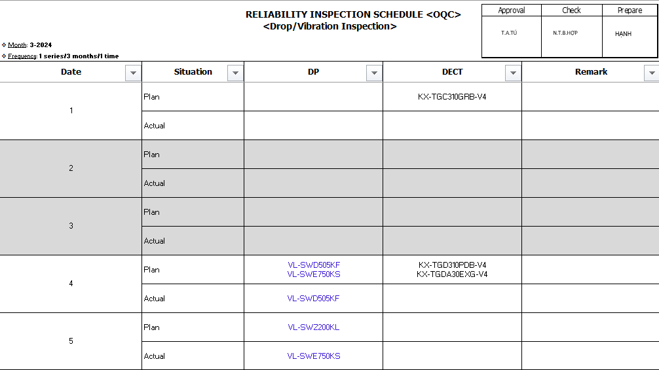
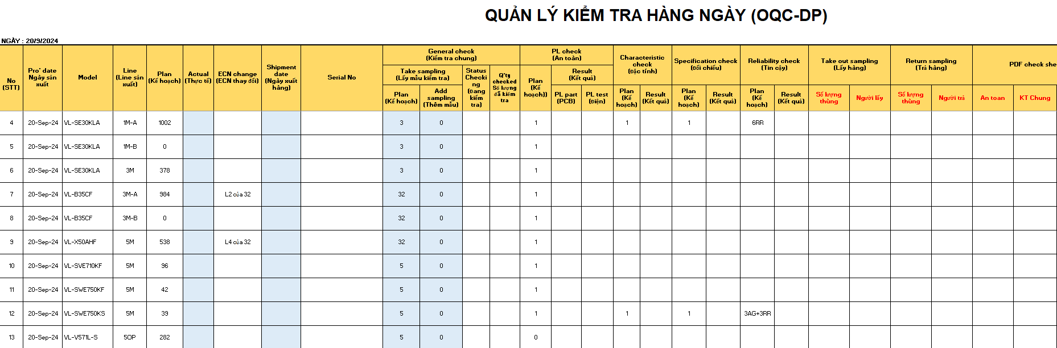
OQC DIGITAL SYSTEM
7
6
OQC re-making production plan base on production plan that PCS send
◆ Current
◆ Proposal
Step 1: PCS send Daily production plan <Email/Server>
OQC make database: Sample Q’ty; Reliability plan
Q’ty sample Standard
Plan
Plan
System will be linked with OQC Inspection plan:
OQC sampling Q’ty (Incase if happen Quality issue, sample Q’ty level will be changed → Return to previous level → OQC make Data base)
Add : 1 column for adjust sample if need to follow up quality issue
Auto assign model that should be Reliability test
Auto change sample Q’ty level (Ex: Normal level → Loosen level)
If cannot catch up plan → Can adjust and display reason (Only OQC member can revise)
Step 2: OQC copy into OQC format to control
OQC re-making production base on information of PCS:
Add some information: Sample Q’ty, PL, Characteristic, Reliability, Specification…
➔ Using time: 10 mins/day
System will link with OQC inspection plan and auto update:
➔ Save time: 10 mins/day

Slide 10
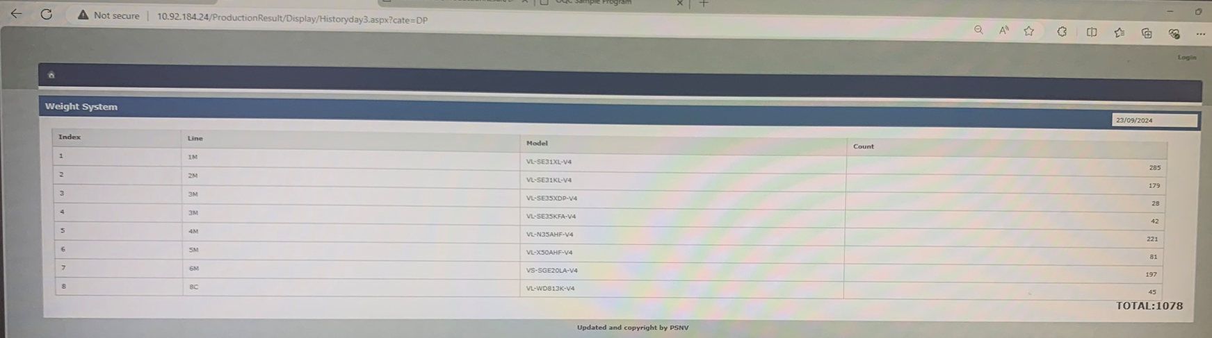
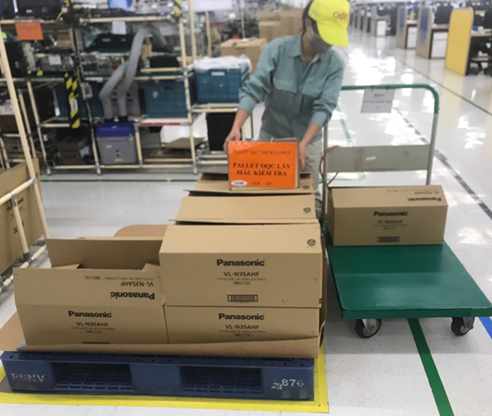
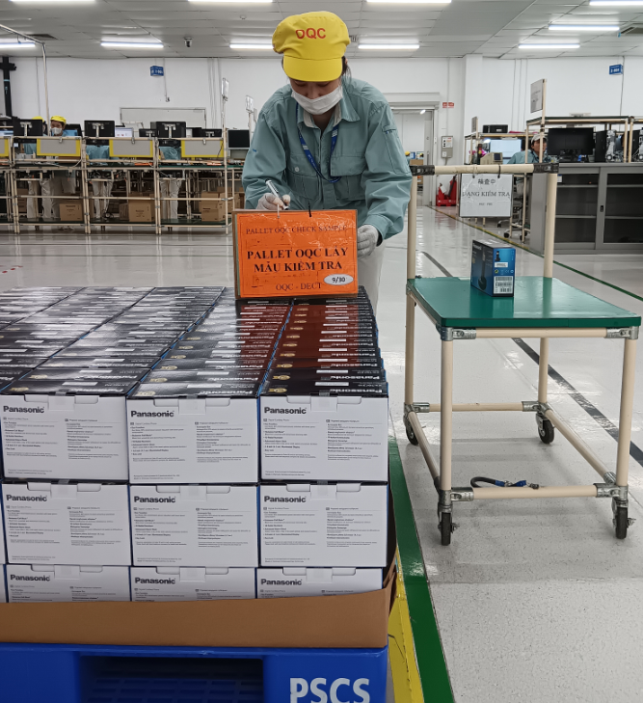
OQC DIGITAL SYSTEM
8
7
OQC pick up sample follow serial range
◆ Current
◆ Proposal
Step 1: Access PSNV Portal to confirm Production result
System can be indicated:
Scan barcode of Outer box → Displays Outer box OQC pick up: FA easy to control sample quantity OQC pick up
System will remind OQC to pick up sample
Indicate time OQC pick up sample on system
Indicate pallet OQC pick up sample to eliminate finding and scan barcode many times
Step 2: Divide serial range to pick up sample at Pallet
DP
DECT
Pick up outer box & put indication
Pick up inner box & put indication
Using time: 1mins*8 times/day=8 mins/day
Save: 8 mins/day

Slide 11
OQC DIGITAL SYSTEM
9
8
Reading barcode Inner/Outer 1st time
◆ Current
◆ Proposal
Reading Barcode of Outer box and Inner box
System link weight check system to confirm Outer box includes which inner boxes
Purpose: To confirm Outer box includes how many inner box and which serial No
Using time: 30lots*10sec*2Outer boxes=10mins/day
Save: 10 mins/day

Slide 12
OQC DIGITAL SYSTEM
10
9
Weight check 1st time offline at OQC to confirm accessory
◆ Current
◆ Proposal
Weight check 1st time (Control offline):
System link weight check system to weight of inner box
Purpose: To confirm full inner box before un-packing
FA already applied weight check system: No need add this point ➔ No need do weight check 1st at OQC
Using time: 150pcs*5sec*2 BD/BU=24mins/day
Save: 24 mins/day

Slide 13
OQC DIGITAL SYSTEM
11
10
OQC normal inspection
◆ Current
◆ Proposal
Current inspection procedure
System link with Database sample Q’ty:
After OQC finish inspection → System indicate result of each serial No (In case NG will be indicated NG situation and reason NG)
System auto confirm matching sample Q’ty with database to indicate changing situation
+ System alarm if inspect duplicated serial No
+ Save history of sample check → Can Traceability
Incase FA happen quality issue → How to indication on system (Prevent OQC judgment OK when FA happen NG) → How to return product of this lot?
Confirm the number of samples to be taken
Appearance check
Function check
Manual confirm sample Q’ty enough or not

Slide 14
OQC DIGITAL SYSTEM
12
11
Reliability inspection:
◆ Current
◆ Proposal
Current inspection procedure
System link with Database sample Q’ty:
OQC make Database about grouping series model need to check Characteristic, Reliability (Monthly)
System auto select model and remind to inspect:
+ Limit Q’ty of model to be suitable with OQC lead time
(For Ex: OQC can check 2pcs characteristic)
+ System default: After Reliability test → Normal inspection.
In case sample not yet checked normal → Will be alarm
+ In case happen Quality issue will be displayed NG situation
and after rework/repair → Change situation (Have history:
Main cause, action)
+ If the model only produced 1 time in a month → Need to
indicate in inspection plan
Confirm checking plan of characteristic, specification, reliability
Basic function check: Power ON check
Inspect: Characteristic, Specification, Reliability
Full function check
Indicate result in OQC control sheet

Slide 15
OQC DIGITAL SYSTEM
13
12
Reading barcode Product Inner to confirm correct serial No
◆ Current
◆ Proposal
Reading barcode Product Inner to confirm correct S/N
Reading barcode Product Inner to confirm correct S/N
OQC make master list product ingredients: Monitor, camera, wireless, charger…
System can auto indicate ingredients must read barcode
Link with FA system to confirm ingredients inside?
This process is re-packing:
+ How to indicate set by set inspection result ?
NG or OK ? Any problem happen ?What is next action ?
+ How this result link to total Judgment ?

Slide 16
OQC DIGITAL SYSTEM
14
13
Weight check 2nd time
◆ Current
◆ Proposal
Weight check 2nd time:
Purpose: To confirm full inner box after packing, compare weight check 1st time & 2nd time for judgment
Weight check 2nd time: Auto link with weight check system of FA to compare weight of inner box and Judgment
FA weight check system
Link
How can detect if FA weight check system have trouble ?

Slide 17
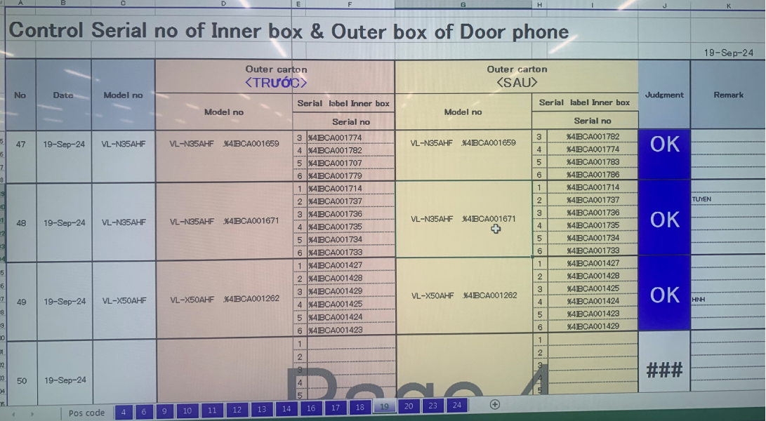
OQC DIGITAL SYSTEM
15
14
Reading barcode Inner/Outer 2nd time to Confirm matching Outer box with inner box
◆ Current
◆ Proposal
Reading barcode Outer & Inner 2nd time
Purpose: Ensure correct Outer box & Inner box
System auto link with FA weight check system
Scan ID outer → Auto link with FA weight check to compare Outer box & inner box
FA weight check system
Link

Slide 18
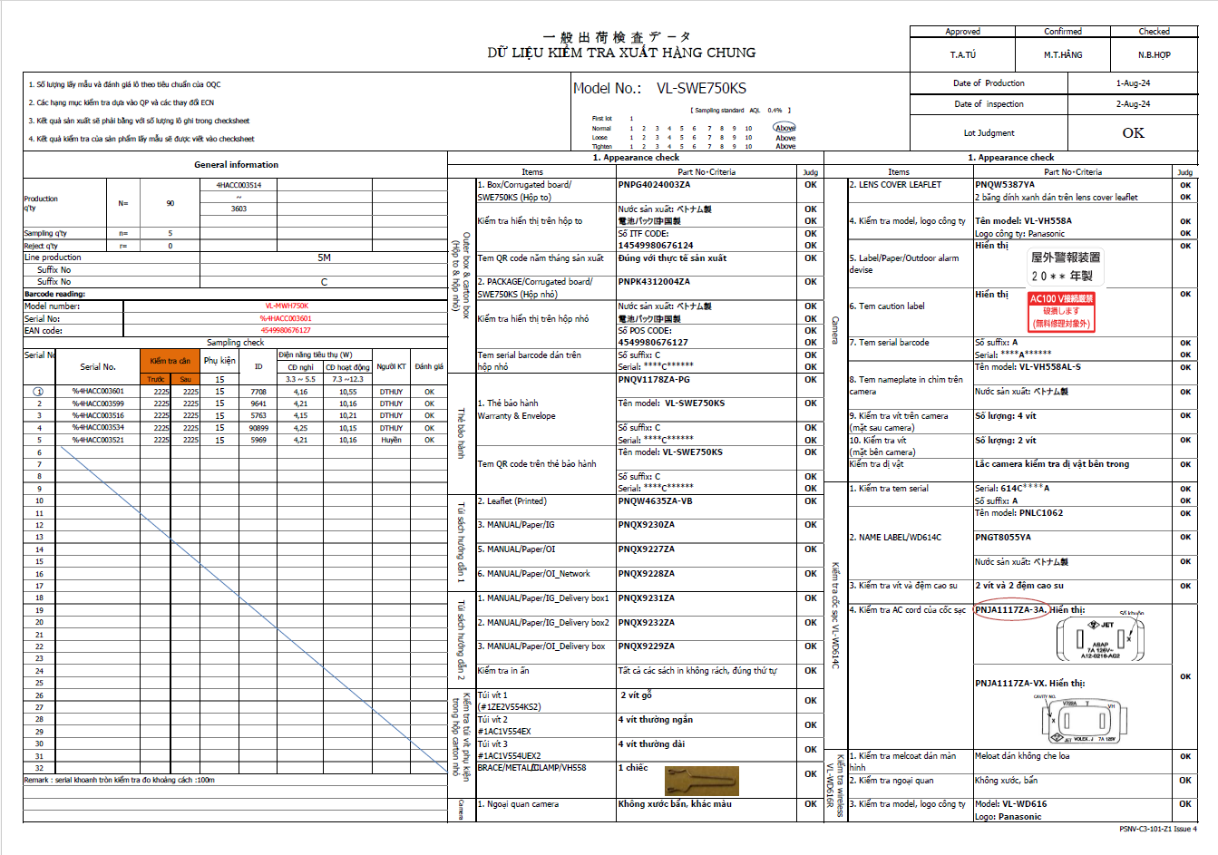
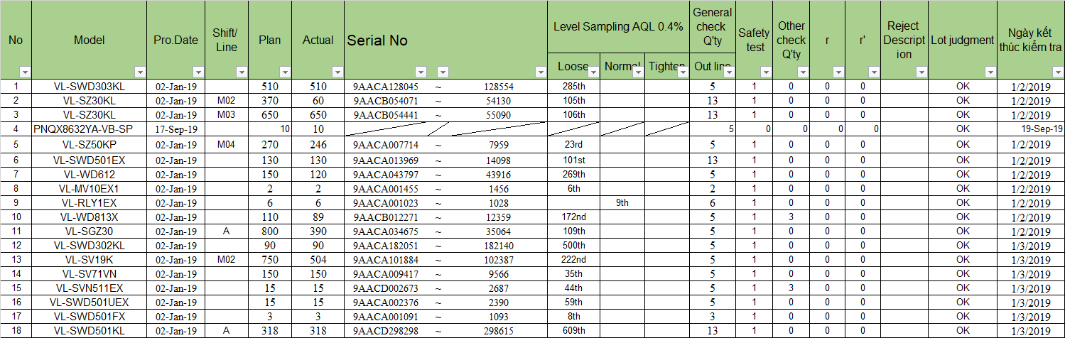
OQC DIGITAL SYSTEM
16
15
Record OQC inspection check sheet and report
◆ Current
◆ Proposal
Current situation:
System auto output OQC inspection result
Manual making OQC inspection check sheet:
System auto output: Production Q’ty, Serial range, FA line, Production date, OQC sample serial No, Inspection date, Sample Q’ty
When reading barcode to start inspection : System link and open OQC check sheet. Then OQC check 1pc complete and indicate OK → Link to system for inspection result
Manual input summary OQC inspection result:
➔ Using time: 10 mins/day
➔Save time: 10 mins/day

Slide 19
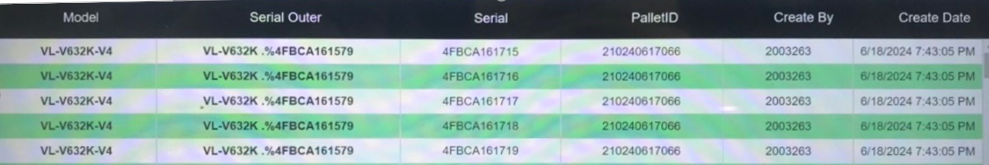
OQC DIGITAL SYSTEM
17
16
Current chop stamp procedure
◆ Current
◆ Proposal
Current situation:
System auto indicate judgment lot
Finding pallet to confirm correct model, Q’ty
Indicate Judgment lot on system → All sections can understand lot situation
Eliminate physical chop stamp
How system link with ID pallet station or how to prevent production move to SCM without OQC approval ?
OQC find Pallet ID
Matching ID Pallet and Outer Carton
OQC chop stamp all ID Pallet
Read ID Pallet & S/N carton box by excel file
Find all same model, production date, line, shift
Chop stamp on Pallet sheet
OK
DD-MM-YY
OQC
Using time:
DP/Dect: 480 mins/day
MW/TV/PJ/SB/PAPVN: 480mins/day
➔Save time: 960 mins/day ~ 2pax

Slide 20
OQC DIGITAL SYSTEM
18
Rule to Judge 1 LOT
Define 1 lot:
When a model runs, another model inserted will be counted as 1 lot. (Lot: when a new model is inserted or finishes a working shift)
Judgment 1 lot:
OQC will judge a lot after finishing the inspection of all sample quantities even though the production result is not finished yes.
1st sample
2nd sample
……
N sample
Final Judgment for Lot
OK
OK
OK
OK

Slide 21
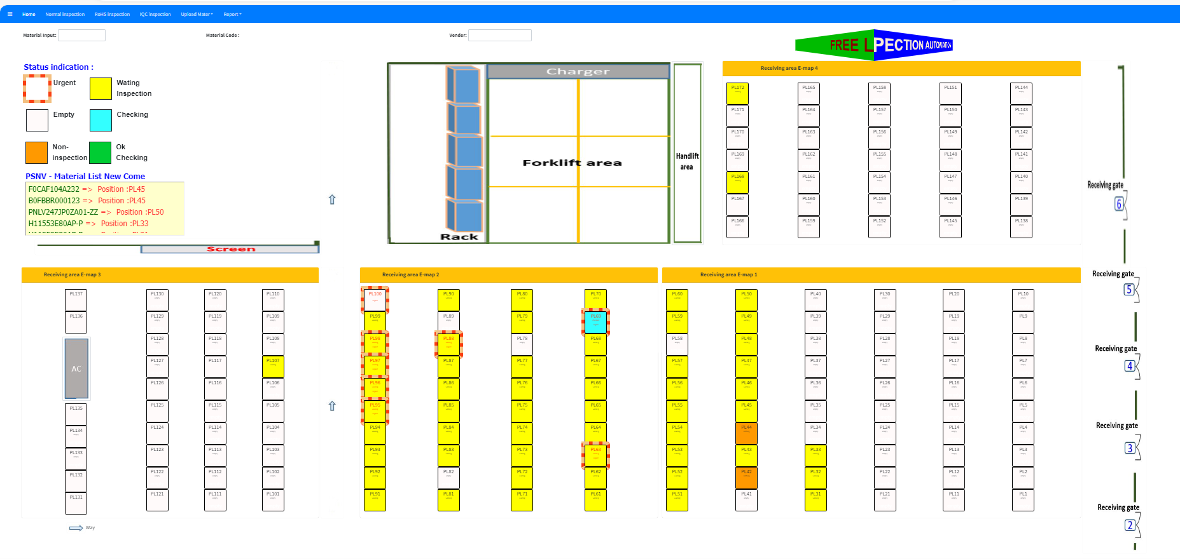
OQC DIGITAL SYSTEM
19
15
Visualize status of Lot
Indication location at warehouse
Status situation
Not checked yet
Checking
Checking
<Can move pallet>
OK
NG
Not checked yet : OQC not taken sample yet
Checking : Under OQC checking
Checking : Under OQC checking (Sample Q’ty already checked over a half Q’ty of all sample)
<Can move pallet>
OK : All Lot judgment OK
NG : Lot judged NG
OQC inspection indication
Location indication at warehouse

Slide 22
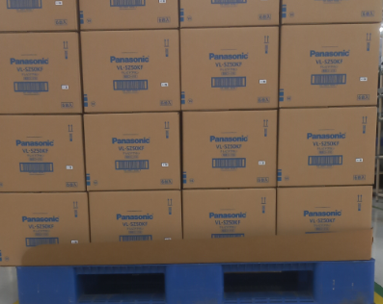

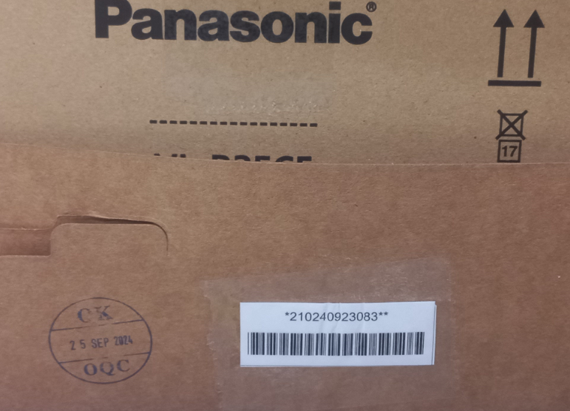
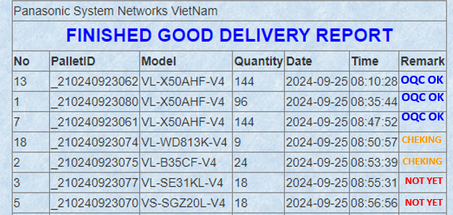
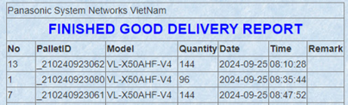
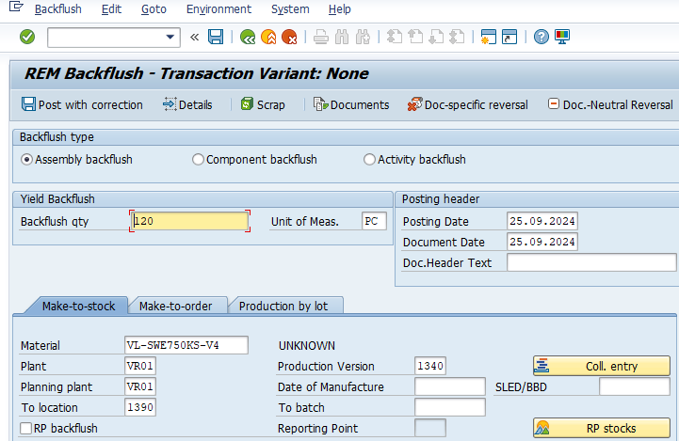
Change method transfer F/G to SCS
FA
20
BEFORE
AFTER
Current process
Improvement process
Production F/G OK
Production F/G OK
FA Make ID ID pallet
FA Make ID ID pallet
Waiting OQC check
Waiting OQC check
OQC stamping OK on slip sheet
OQC stamping OK on System
OQC OK
Manual check OQC OK
OQC OK
Check OQC OK by PDA
OQC OK
Download ID pallet scaned
LINK
Download ID pallet scaned
FA transfer SCS (SAP system)
Auto transfer
SCS (SAP system)
Print movement slip
Print movement slip
SCS Receive the finish goods Scan ID Pallet Code
FA transfer SCS (Actual)
FA transfer SCS (Actual)
Currently
Manual check OQC display OK
Manual transfer F/G to SCS (SAP system)
Printing hard movement slip: 3600pcs/monthly ⬄ 7.2Ream
Cost: 7.2*2.47$ = 17.78$/month ~ 213.4$/Year
Improvement
Check OQC OK by PDA
Auto transfer F/G to SCS (SAP system)
Abolish hard movement slip: 7.2Ream
Save Cost: 213.4$/Year
Reduced : 213.4 S/Y

Slide 23
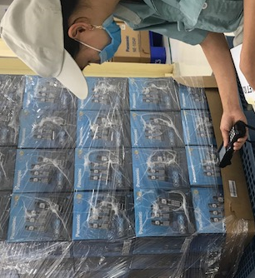
OQC DIGITAL SYSTEM LINK WMS & CONFIRMATION DATA
SCM
21
SCS request:
Visualize status of model following shipment plan daily
Link final confirmation to WMS/PDA for operator working in warehouse
DASHBOARD
LINK WMS/PDA
Option 1
FA
OQC
SCS
WMS
①
Judgement auto email
FA transfer cargo to SCS
Shipment plan
Dashboard
Finish production
Sampling inspection
Shipment plan
*
Option 2
*
①
PSNV Portal
“Control shipping plan”
Pallet ID finish
Warning to dashboard
SCS visualize on pallet
②
Scan ID pallet
Result NG
FA/QC recheck
Judgement OK
Judgement OK
Scan ID pallet to receive
Result judged OK
Confirm data PDA
③
Email auto
Confirm receiving
Auto update
③
WMS
SCS check all data by download
**
Confirm receiving
**
Dashboard
Format check

Slide 24
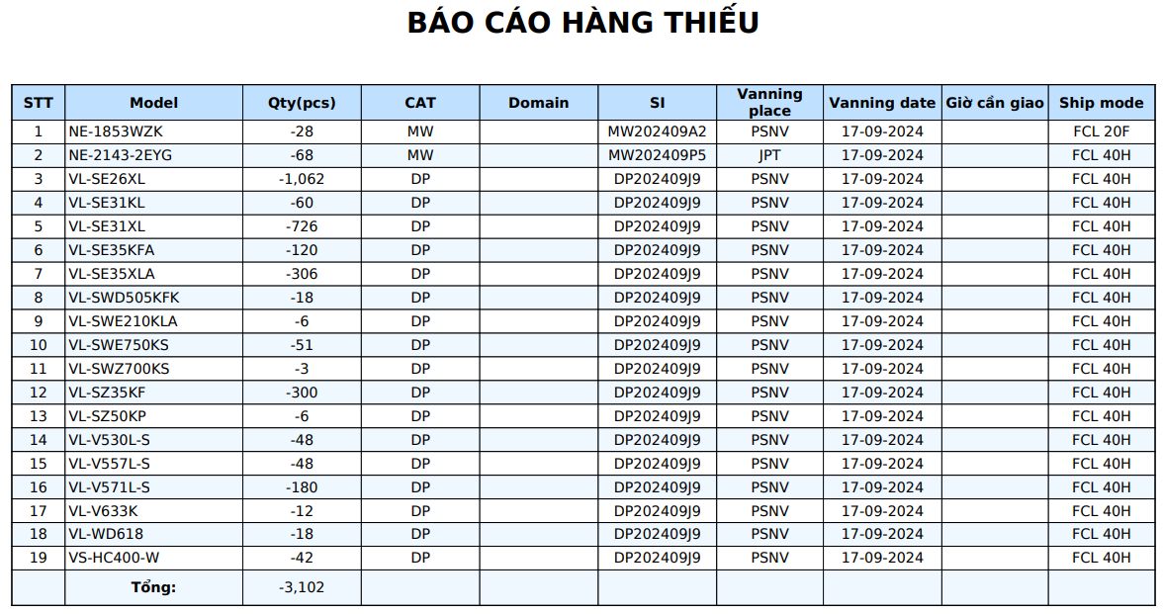
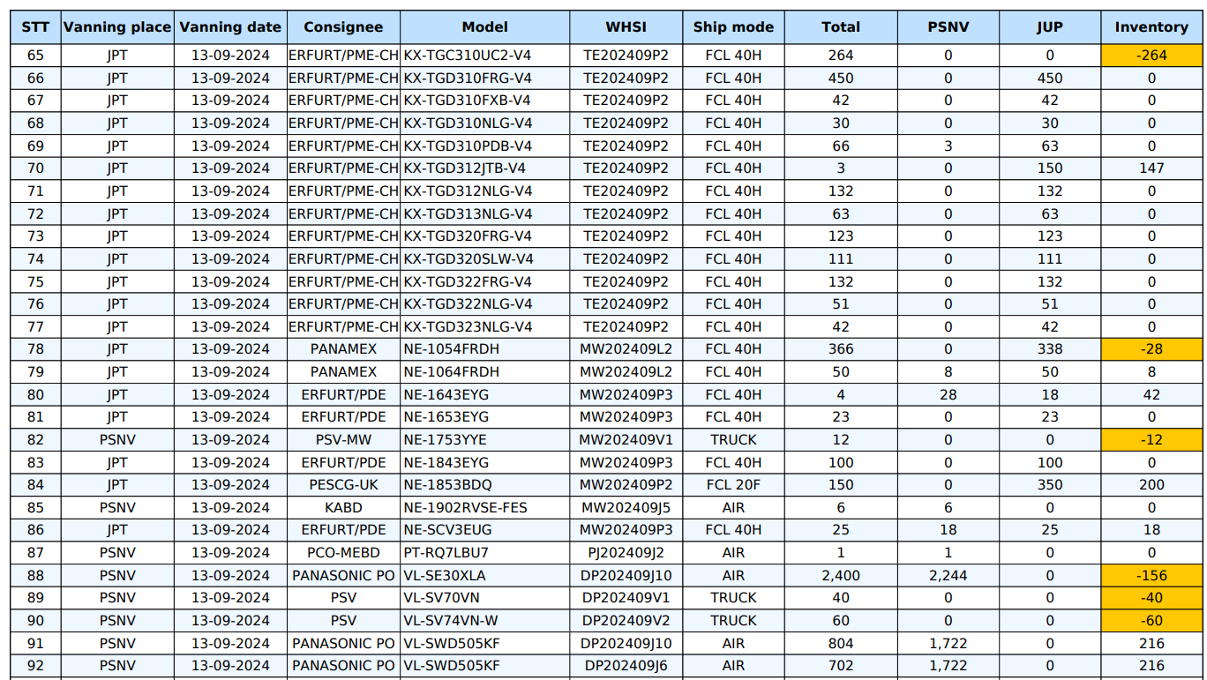
OQC DIGITAL SYSTEM LINK WMS & CONFIRMATION DATA
SCM
22
Details shortage shipment plan daily on WMS
Shortage shipment plan daily on WMS
FORMAT DOWNLOAD FROM DASHBOARD

Slide 25
OQC DIGITAL SYSTEM
Analysis of OQC System Functional Diagram
Make Planning
SCM
Send file inventory & shipment plan
FA
Compare Stock base on file plan and update
OQC
PCS
Send daily production plan
Step 1
OQC
Filter priority shipmen models to inspection
Input daily production to excel file
Pick up sample to Inspection
Based on the production plan file of SCM
Based on sample standard file
Pick up samples based on weight check system results
Step 2
OQC
Scan barcode outer serial
Scan all barcodes inner serial
Confirm S/N Outer & all inner boxes

Slide 26
OQC DIGITAL SYSTEM
Analysis of OQC System Functional Diagram
Step 3
OQC
Weight check 1st
Product weight control
Step 4
Normal inspection
Appearance inspection, function, WI
OQC
OQC
inspection
Reliability inspection
Characteristic, Vibration, Drop, Temperature test
Step 5
OQC
Scan barcode inner product
Based on the mater list

Slide 27
OQC DIGITAL SYSTEM
Analysis of OQC System Functional Diagram
Step 6
OQC
Weight check 2nd
Product weight control
Step 7
OQC
Scan barcode outer serial
Scan all barcodes inner serial
Confirm S/N Outer & all inner boxes
Step 8
OQC
Return sample
Judgment all Lot

Slide 28
OQC DIGITAL SYSTEM
Chop stamp process of OQC
Packing FA
FA shrink Pallet ID
ID Pallet Station
FA warehouse
SCM warehouse
Case 1
NO ID Pallet
Report daily by excel
Case 2
ID Pallet issue in FA process
14
OQC get sample
None Pallet
OQC get sample
Chop stamp physical all lots
13
Return sample
OQC Inspection
Find all lots same model, date, line, shift
OQC Inspection
NG
OK
12
NG
11
Record Pallet ID & SN carton by excel
return sample
9
OK
9
Find Pallet ID & FG
10
Matching ID Pallet and Outer carton before return
Find & Return correct Pallet ID taken
Notify NG error for FA

Slide 29
OQC DIGITAL SYSTEM
Schedule OQC Digital System
Plan
Actual
Go-live
No | Items | Dept | Aug | Sep | Oct | Nov | Dec | Jan | Feb | Mar
1 | Meeting, discuss, analyze | SCM/QC/FA/IT
2 | Confirm shortage shipment | SCM/QC/IT
3 | Upload production plan | SCM/QC/IT
4 | Pick-up sample | QC/IT
5 | Confirm Outer carton and inner box | QC/IT
6 | Modify weight check OQC | QC/IT
7 | OQC normal inspection | QC/IT
8 | OQC Reliability inspection | QC/IT
9 | Confirm all serial of product for ensure matching serial No | QC/IT
10 | Return sample | QC/IT
11 | Function OQC judgment all lot for production result | MCS
12 | Visualize inspection result OQC for FA | PMD
13 | Visualize inspection result OQC for SCM | PMD
14 | Visualize inspection result OQC with WMS of SCM | FA
15 | Report daily OQC | SCM

